Slide 1


Cleckhuderfax E-Chain WIP Presentation
Created by The Influencers (Group – 5) Project Manager: Rohit Pandey
Sponsored by: The British College

Slide 2

Team Members

Slide 3
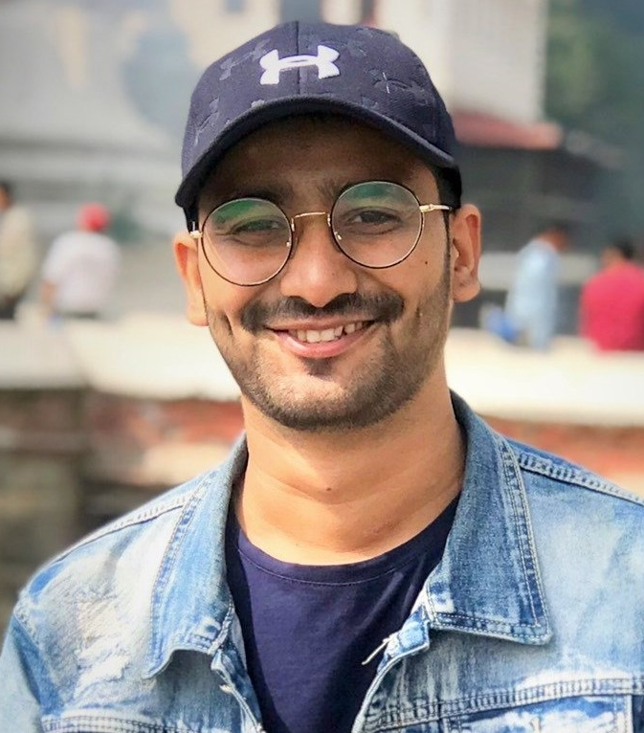
Bijay Giri
Roles : Co-Ordinator, Specialist, Monitor Evaluator

Slide 4
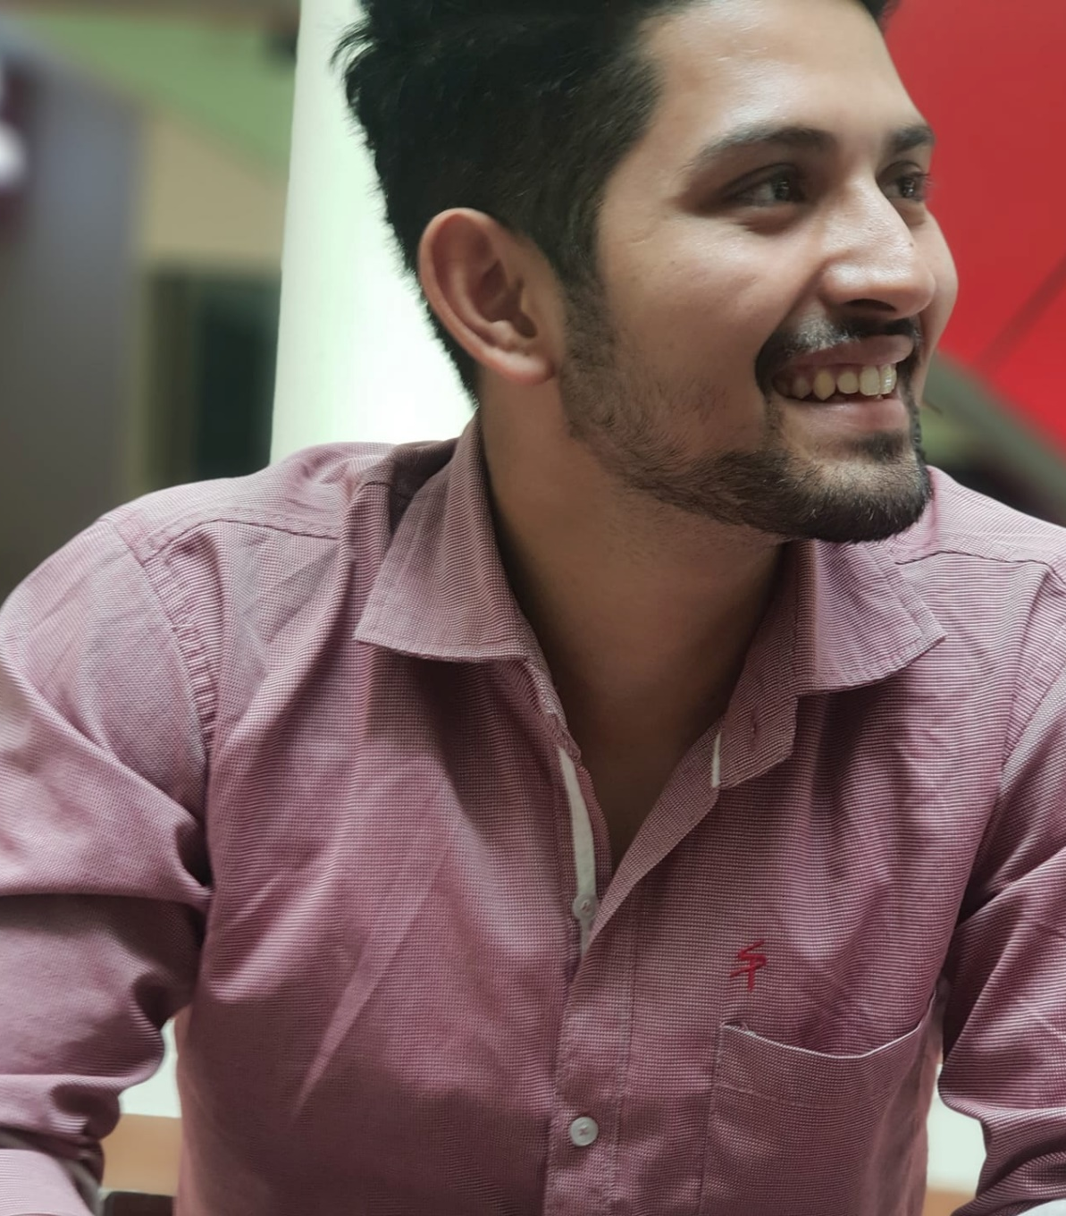
Dipesh B.C.
Roles : Specialist, Plant, Co-ordinator

Slide 5
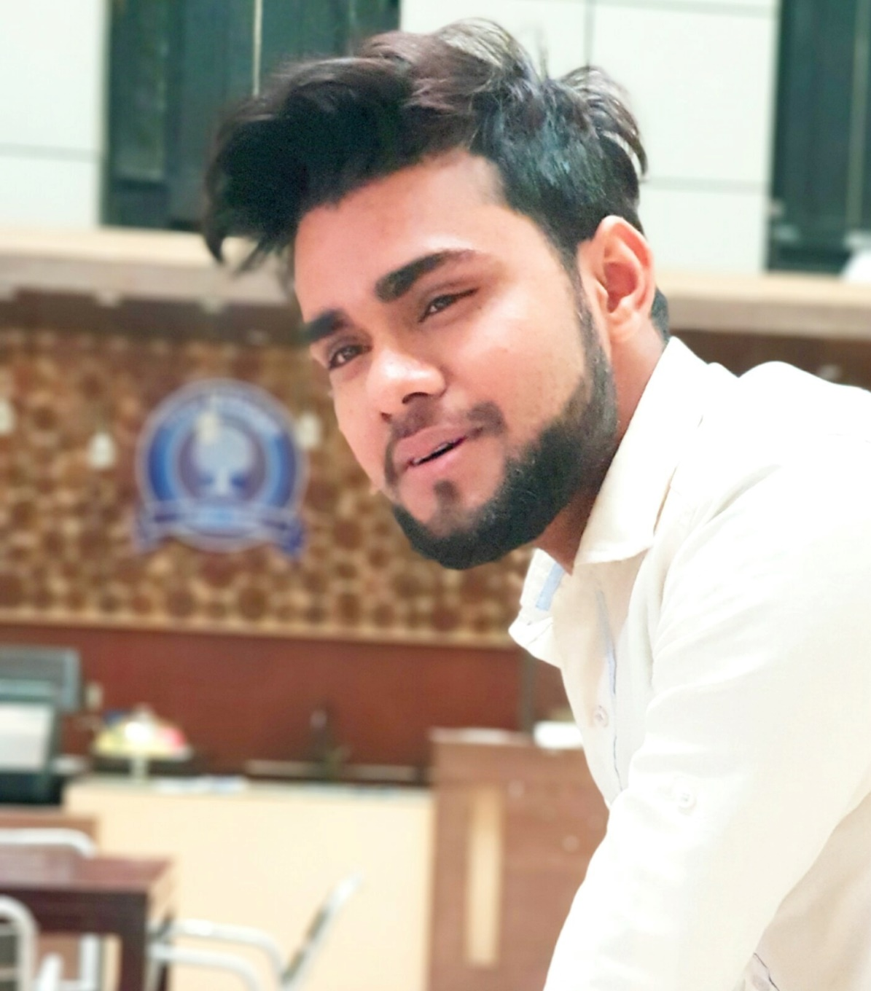
Kadamber Verma
Roles : Implementor, Complete Finisher, Resource Investigator

Slide 6

Rajbir Chand
Roles : Shaper, Monitor Evaluator, Resource Investigator

Slide 7

Sushant Tiwari
Roles : Team worker, Co-Ordinator, Resource Investigator

Slide 8
Website logo

Slide 9
Overview
As national chains have started to find space in Cleckhuddersfax the competition in the market is starting to rise and the traders are afraid that they won’t be able to compete on opening hours without losing out on family life. The Clehuderfax E-Chain project is our solution for this problem. This is a joint E-commerce platform for the locals of Cleckhuddersfax. Not only the traders will now be able to manage their work just by the website sitting at their home without losing out their family time, the peoples that were previously unable to shop in the opening hours because of their work will now they will also be able to shop because of this platform.

Slide 10

Skills Audit

Slide 11
NO# | Skill Required | Skill Level ( 1- 5) | Training Action | Training Objective | Time (hrs) | Training Completion Deadline | Training for?
1 | PHP Programming | 3 | Follow youtube tutorials and PHP official documentation. | Become more confident in the use of PHP and in the building of shopping cart. | 2 | 3/8/2019 | Dipesh B.C., Bijay Giri, Rajbir Chand, Kadamber Verma, Sushant Tiwari.
2 | Bootstrap | 3 | Follow youtube tutorials and Bootstrap official documentation. | Become more confident in the use of Bootstrap and in the building of responsive website. | 2 | 3/8/2019 | Dipesh B.C., Bijay Giri, Rajbir Chand, Kadamber Verma, Sushant Tiwari.
3 | Front End Design | 3.8 | Follow w3school link and HTML/CSS Tutorial. | Become more confident in the use of wireframe and to build attractive and user-friendly website design. | 2 | 3/8/2019 | Dipesh B.C., Bijay Giri, Rajbir Chand, Kadamber Verma, Sushant Tiwari.
4 | Wireframe | 4.4 | Follow youtube tutorials and study materials from college. | Become more confident in the use of wireframe and to design a better page layout or arrangement of the website's content, including interface elements and navigational systems. | 2 | 3/8/2019 | Dipesh B.C., Bijay Giri, Rajbir Chand, Kadamber Verma, Sushant Tiwari.
5 | Mindmap | 4.6 | Follow youtube tutorials. | Become better at representing ideas and concepts. | 2 | 3/8/2019 | Dipesh B.C., Bijay Giri, Rajbir Chand, Kadamber Verma, Sushant Tiwari.
6 | Photoshop | 4 | Follow youtube tutorials. | To develop skills in editing and altering photographs for the website. | 2 | 3/8/2019 | Dipesh B.C., Bijay Giri, Rajbir Chand, Kadamber Verma, Sushant Tiwari.
7 | Illustrator | 4 | Follow youtube tutorials. | Helps in developing logo for our website. | 2 | 3/8/2019 | Dipesh B.C., Bijay Giri, Rajbir Chand, Kadamber Verma, Sushant Tiwari.
8 | EERD/ERD/UML/Conceptual Design | 4.2 | Follow Youtube tutorials and study materials from college. | Become better at creating database and to create a well managed database for our website. | 2 | 3/8/2019 | Dipesh B.C., Bijay Giri, Rajbir Chand, Kadamber Verma, Sushant Tiwari.

Slide 12
9 | Java Script | 2.8 | Follow MDN web docs and youtube tutorials. | Become more confident in the use of Java Script and in particular in the event handling using AJAX request from website elements. | 2 | 3/8/2019 | Dipesh B.C., Bijay Giri, Rajbir Chand, Kadamber Verma, Sushant Tiwari.
10 | Apex Oracle | 3.6 | Follow youtube tutorials and official Oracle documentation. | To create interface for our website's backend. | 2 | 3/8/2019 | Dipesh B.C., Bijay Giri, Rajbir Chand, Kadamber Verma, Sushant Tiwari.
11 | MS project | 3 | Follow youtube tutorials and study materials from college. | Become better at developing plans, assigning resources to tasks, tracking progress, managing budgets and analysing workloads. | 2 | 3/8/2019 | Dipesh B.C., Bijay Giri, Rajbir Chand, Kadamber Verma, Sushant Tiwari.
12 | Oracle Database | 2.8 | Follow youtube tutorials and official Oracle documentation. | To create table and store data. | 2 | 3/8/2019 | Dipesh B.C., Bijay Giri, Rajbir Chand, Kadamber Verma, Sushant Tiwari.
13 | API | 2.8 | Follow youtube tutorials and API developer documentation. | To implement payment gateway. | 2 | 3/8/2019 | Dipesh B.C., Bijay Giri, Rajbir Chand, Kadamber Verma, Sushant Tiwari.
14 | PL/SQL | 3.4 | Follow youtube tutorials and references from TutorialsPoint. | To manipule, collect large volume of data and apply algorithms. | 2 | 3/8/2019 | Dipesh B.C., Bijay Giri, Rajbir Chand, Kadamber Verma, Sushant Tiwari.
15 | Slack, Trello | 4.4 | Follow youtube tutorials. | To become better manage communication, events and in tracking progress. | 2 | 3/8/2019 | Dipesh B.C., Bijay Giri, Rajbir Chand, Kadamber Verma, Sushant Tiwari.
16 | Github | 3.8 | Folllow youtube tutorials. | To become better at tools provided by GitHub for version control of our website. | 2 | 3/8/2019 | Dipesh B.C., Bijay Giri, Rajbir Chand, Kadamber Verma, Sushant Tiwari.
17 | Adobe XD | 3 | Follow youtube tutorials. | To develop prototype for user experience. | 2 | 3/8/2019 | Dipesh B.C., Bijay Giri, Rajbir Chand, Kadamber Verma, Sushant Tiwari.
18 | Microsoft Powerpoint | 4.2 | Follow youtube tutorials. | To make professional presentation for our website. | 2 | 3/8/2019 | Dipesh B.C., Bijay Giri, Rajbir Chand, Kadamber Verma, Sushant Tiwari.

Slide 13
Requirements Catalogue

Slide 14
Part A: Customer Interface

Slide 15
REQUIREMENT ID | DESCRIPTION | MOSCOW RULE
A1-F | An Interface that allows the customers to view product
A1F-01 | Users should be able to navigate products by shop or by product type. | M
A1F-02 | The product of each traders will not overlap, and products will be unique to them. | M
A1F-03 | Viewable on mobile as well as desktop devices and viewable on the most popular browsers. | M
A1F-04 | Each product will have name, product type, short description, quantity, price, image and traders. | M
A1F-05 | Customer registration and login system. | M
A1F-06 | Customer will be able to view ten shops. | M
A1F-07 | Customer will be able to check out and select collection slots. | M
A1F-08 | Customers will be able to make payment via online payment gateway. | M

Slide 16
A1F-09 | Users will be able to search products by open search. | S
A1F-10 | Users will be able to access their account and can update, edit, delete their account info including profile pictures. | S
A1F-11 | Users will be able to rate a product and provide a product review. | S
A1F-12 | Users will be able to sort products using filter such as price, ascending and descending order. | S
A2F | The Interface will allow the customers to select activities to temporarily store in a favorites collection
A2F-01 | Single basket that holds goods that spans all traders and requires a single payment. | M
A2F-02 | Customers will be able to view their orders | M
A2F-03 | Customers will be able to view total price | M
A2F-04 | The Cart will list product with a thumbnail image, price, quantity, total price and checkout or indicate no favorites are saved.
A2F-05 | Customers should be able to remove individual item or all from cart | S

Slide 17
Part B: Registration and Login

Slide 18
REQUIREMENT ID | DESCRIPTION | MOSCOW RULE
B1F | Interface that allows new user registration and user login
B1F-01 | A login form for collecting username/email and password. | M
B1F-02 | Login button will be displayed on every page if the user is not logged in. | S
B1F-03 | Registration form for unregistered user login attempt. | M
B1F-04 | Server-side validation for user registration and user login. | S
B1F-05 | Server validation that informs users if they attempt to log in using incorrect details | M
B2F | Interface for user and trader login
B2F-01 | A form that collects first name, last name, email, address, mobile number, password and terms and conditions checkbox for user registration | S
B2F-02 | User registration confirmation through email address | S

Slide 19
B2F-03 | A form that collects first name, last name, email, address, mobile number, shop name, password and terms and conditions checkbox for trader registration | S
B2F-04 | Traders registration confirmation through email address | S
B2F-05 | Server-side validation so that none of the fields are left empty or filled with wrong data. | S
B2F-06 | Password should be encrypted before storing in database | S
B2F-07 | Application of appropriate functions and techniques to combat security risks posed by data being entered into form | S
B2F-08 | Application of appropriate functions and techniques to ensure validity of data entered including valid email; names - alpha only; password includes at least one capital letter, a number and a symbol | C
B2F-03 | A form that collects first name, last name, email, address, mobile number, shop name, password and terms and conditions checkbox for trader registration | S
B2F-04 | Traders registration confirmation through email address | S
B2F-05 | Server-side validation so that none of the fields are left empty or filled with wrong data. | S
B2F-06 | Password should be encrypted before storing in database | S

Slide 20
Part C: Trader Interface

Slide 21
REQUIREMENT ID | DESCRIPTION | MOSCOW RULE
C1F-01 | All products will have unique product ID, associated only with Trader. | M
C1F-02 | Traders should be able to login and access their details only. | M
C1F-03 | Homepage/dashboard for the trader | M
C1F-04 | Traders should be able to access CRUD operation for their shop products. | M
C1F-05 | Clicking the Delete link will remove the chosen item and update the displayed catalogue of items . | S
C1F-06 | Clicking the update link will show a form prepopulated with all editable details. Submitting the form will update the chosen item and display the updated item. | S
C1F-08 | A facility will be provided to allow for the upload of new images for a new item when added. | C
C1F-09 | Traders should be able to edit and modify their trader account. | C
C1F-10 | Traders will be able to login to the database daily to view reports on orders and stock levels. | S

Slide 22
Part D: Admin Interface

Slide 23
REQUIREMENT ID | DESCRIPTION | MOSCOW RULE
D1F-01 | An active admin link will be provided once an admin user has logged in. | S
D1F-02 | Admin home page or dashboard for admin | M
D1F-03 | The admin page will display all activities with the option to create a new item, delete or update each item . | M
D1F-04 | An admin login that can access any of the trader accounts. | S
D1F | A facility to allow authenticated admin users to manage the activities presented by the system
D1F-01 | An active admin link will be provided once an admin user has logged in. | S
D1F-02 | Admin home page or dashboard for admin | M
D1F-03 | The admin page will display all activities with the option to create a new item, delete or update each item . | M

Slide 24
Part E: Management Interface

Slide 25
REQUIREMENT ID | DESCRIPTION | MOSCOW RULE | REQUIREMENT ID
E1F | A facility to allow authenticated admin users to manage the activities presented by the system |  | E1F
EF-01 | A management dashboard is required. | M | EF-01
EF-02 | Management dashboard should provide the traders access to a range of daily and periodic reports | S | EF-02
EF-03 | Daily reports will be generated which will identify the goods and quantities that have been ordered. | M | EF-03
EF-04 | Reports should be presented so that it is clear which delivery slots goods are required for and they will use this information to label goods for collection with a customer ID and order ID as well as product details. | M | EF-04
EF-05 | Traders will be provided with a weekly finance report which will identify payments to be made | S | EF-05
EF-06 | Traders will be provided with a monthly report on their product sales | S | EF-06
EF-07 | Report can be viewed ordered in several ways: alphabetically, by total number of orders per product, by total income per product. | S | EF-07

Slide 26
Part F: Non-Functional Requirement

Slide 27
REQUIREMENT ID | DESCRIPTION | MOSCOW RULE
F1F | The website will comply with the following nonfunctional requirements
FF-01 | HTML/CSS template suited to requirements. | M
FF-02 | Website designed as per wireframe | M
FF-03 | Template applied consistently throughout the site | S
FF-04 | Site built for maintainability: Files organized, comments added, HTML using includes, bespoke functions. | S
F1F | The website will comply with the following nonfunctional requirements
FF-01 | HTML/CSS template suited to requirements. | M
FF-02 | Website designed as per wireframe | M

Slide 28
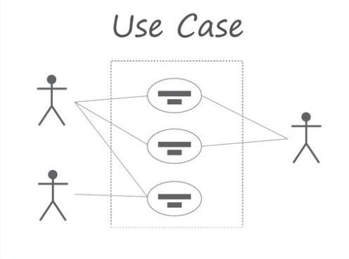
Use Case

Slide 29
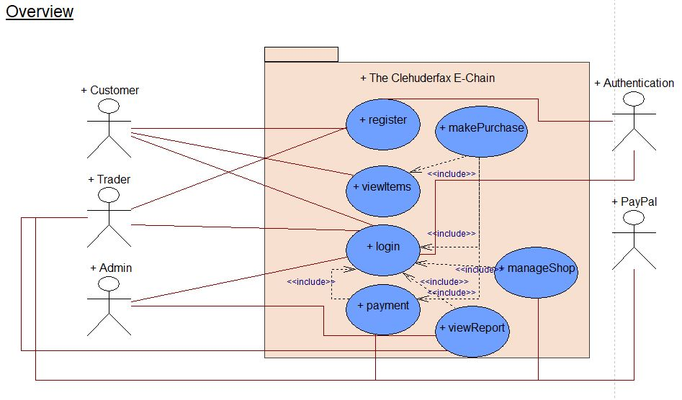
Overview

Slide 30
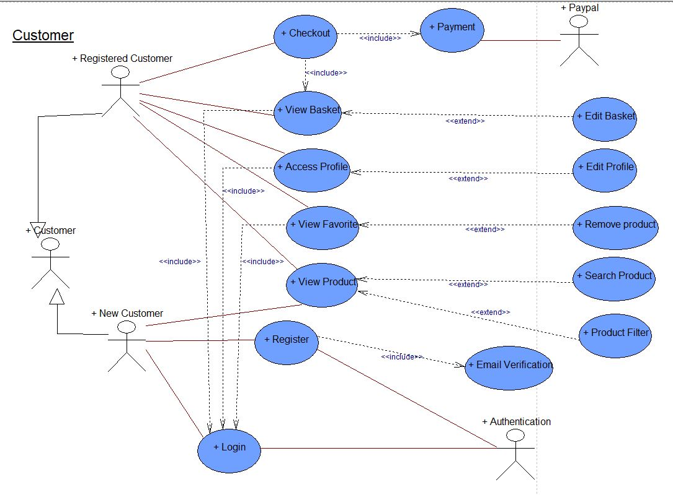
Customer

Slide 31
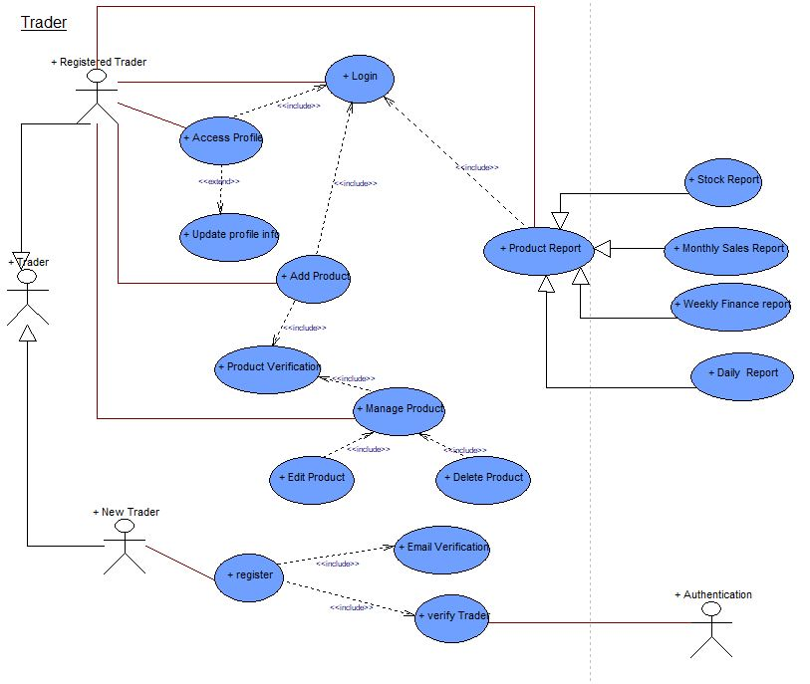
Trader

Slide 32
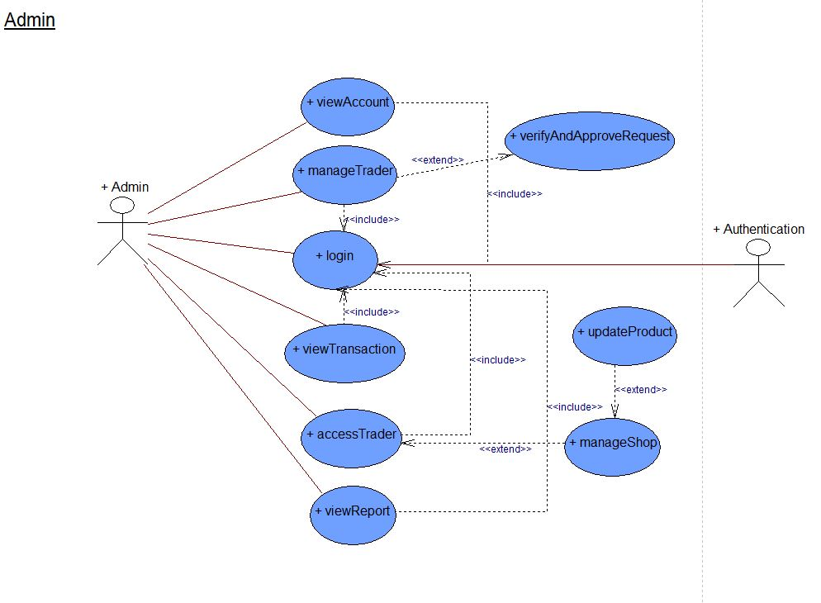
Admin

Slide 33

Entity Relationship Diagram

Slide 34
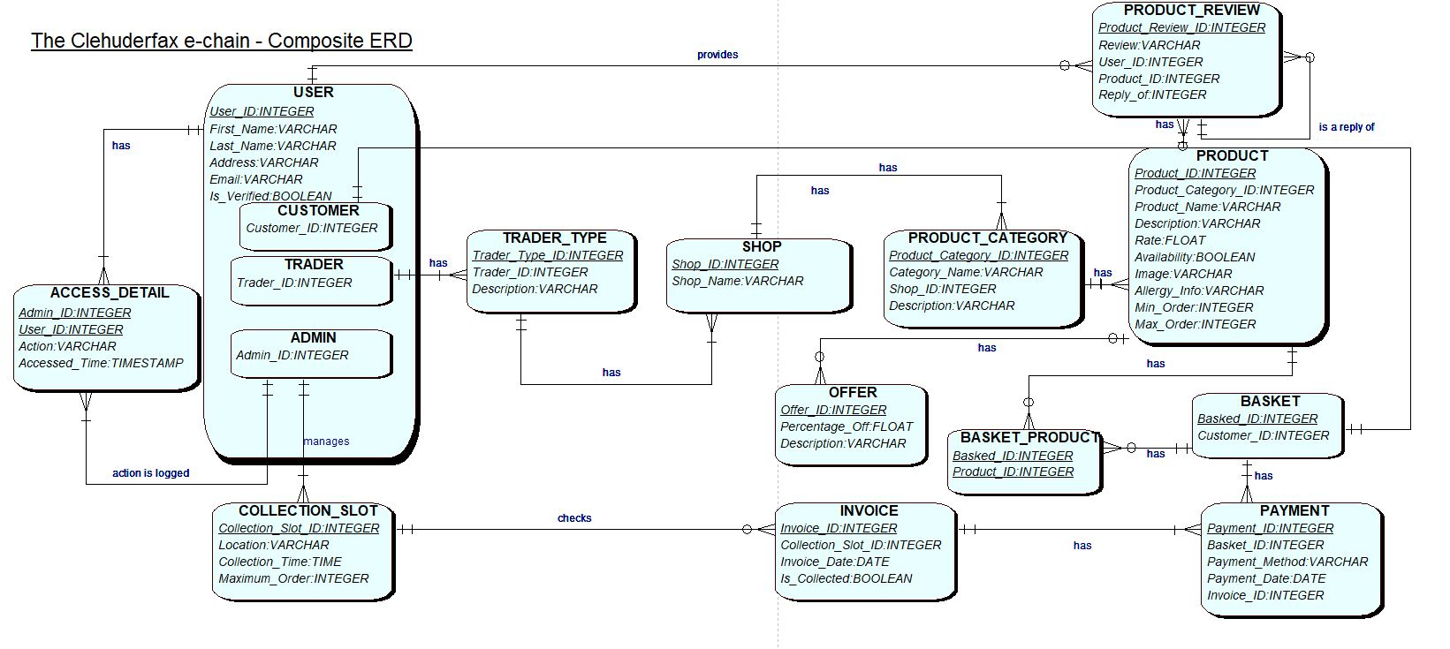
Composite Diagram

Slide 35

MS Project

Slide 36
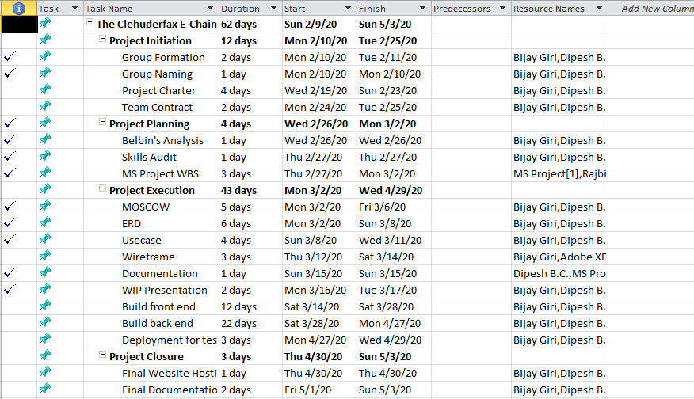
Task Sheet

Slide 37
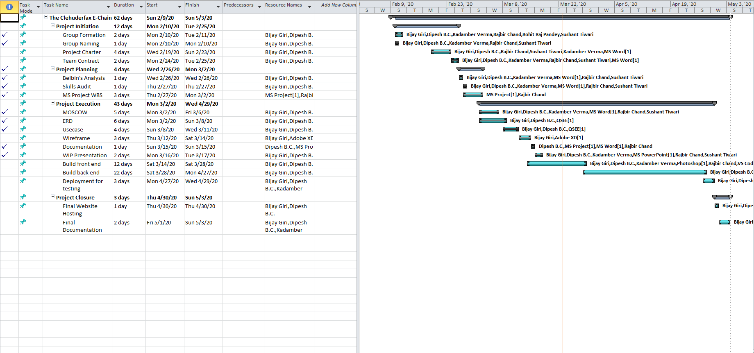
Gantt Chart

Slide 38
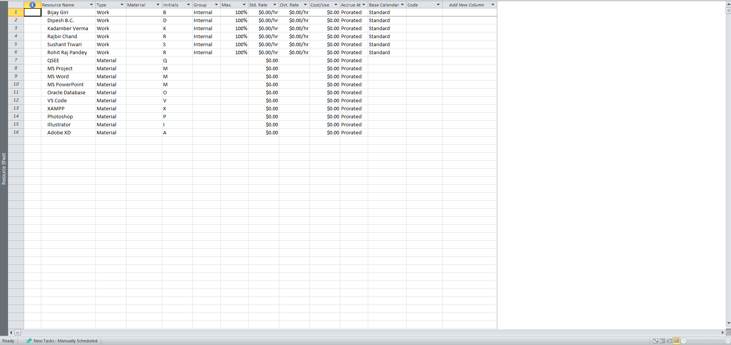
Resource Sheet

Slide 39
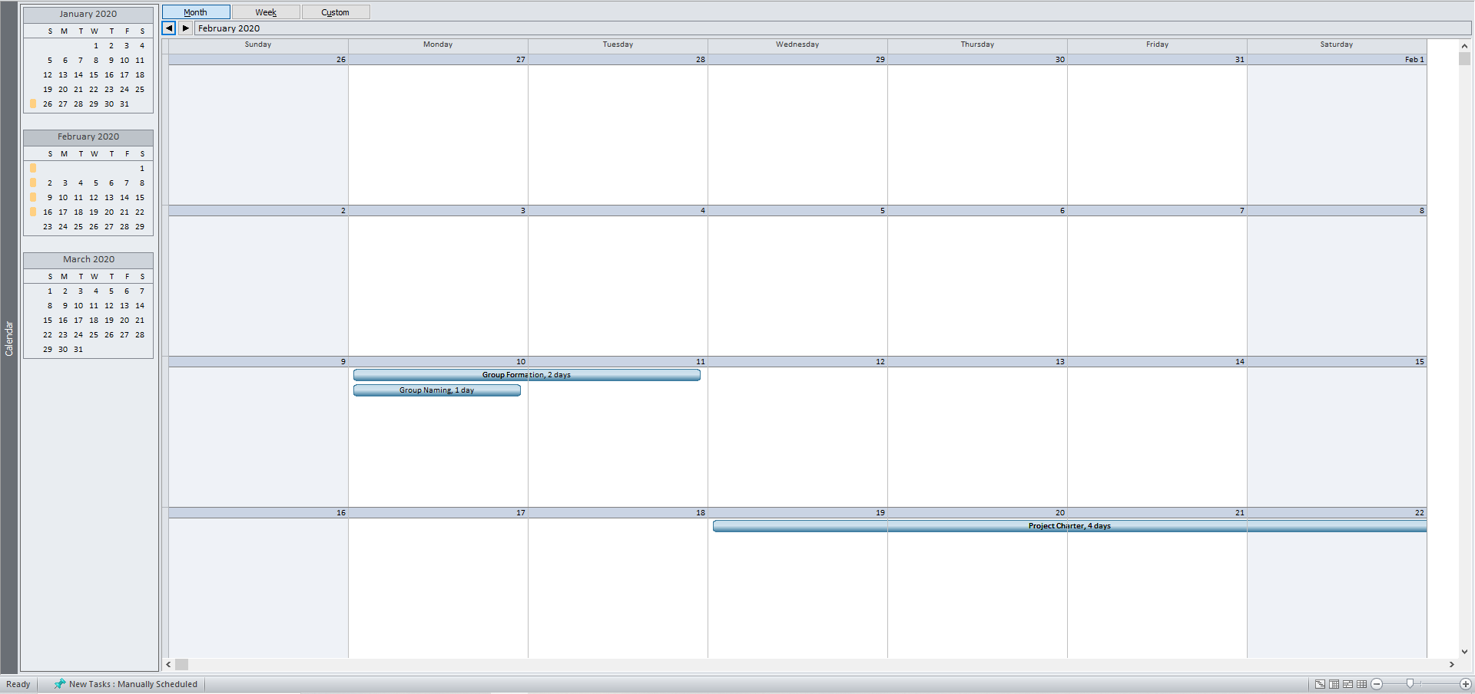
Calendar

Slide 40
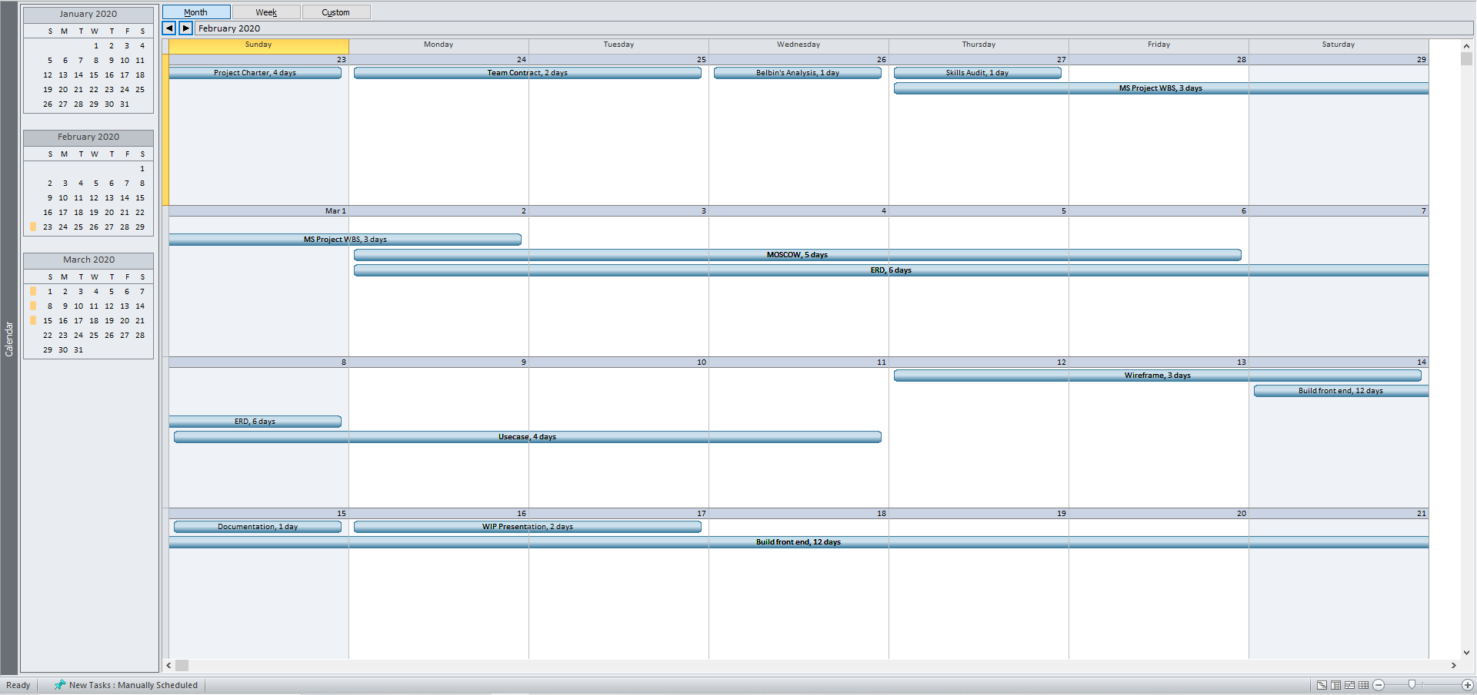
Calendar

Slide 41
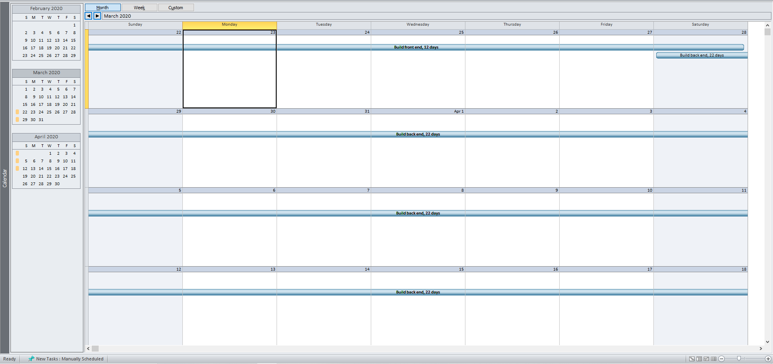
Calendar

Slide 42
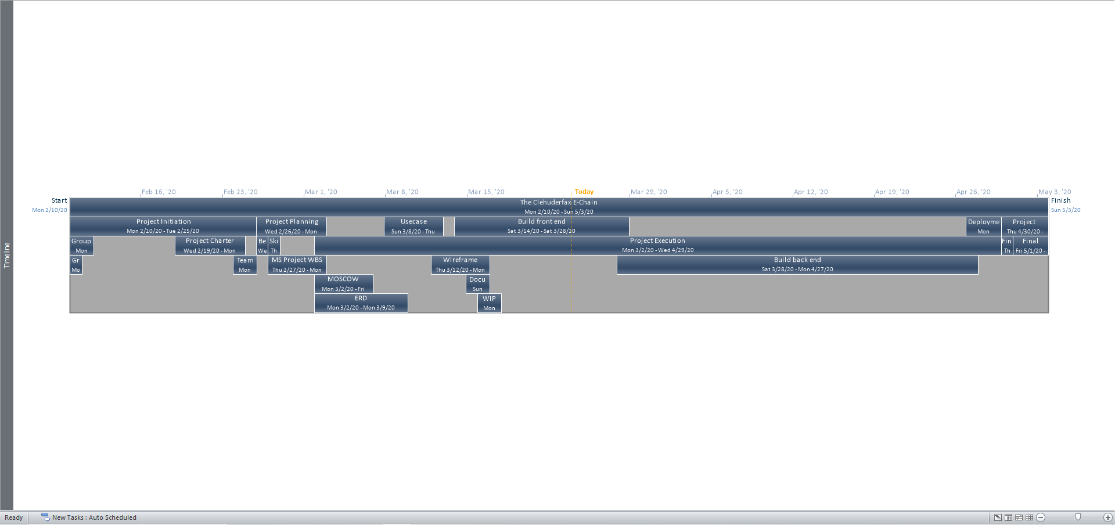
Timeline

Slide 43
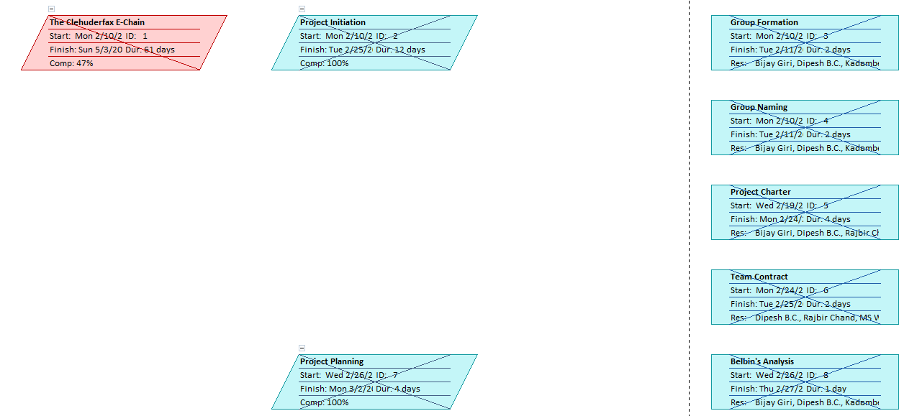
Network Diagram

Slide 44
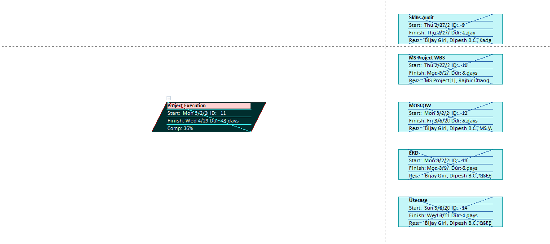
Network Diagram

Slide 45
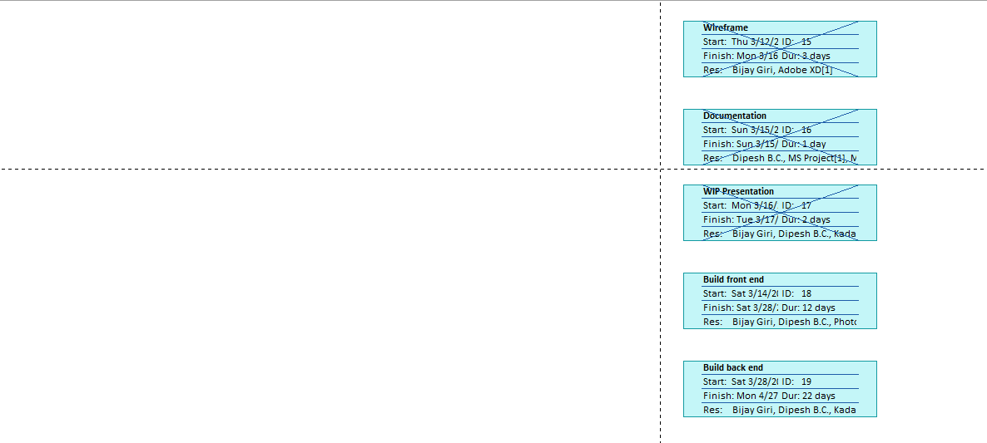
Network Diagram

Slide 46
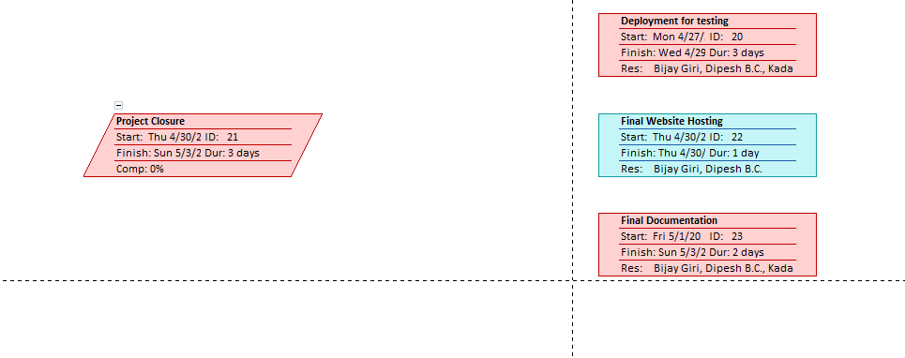
Network Diagram

Slide 47
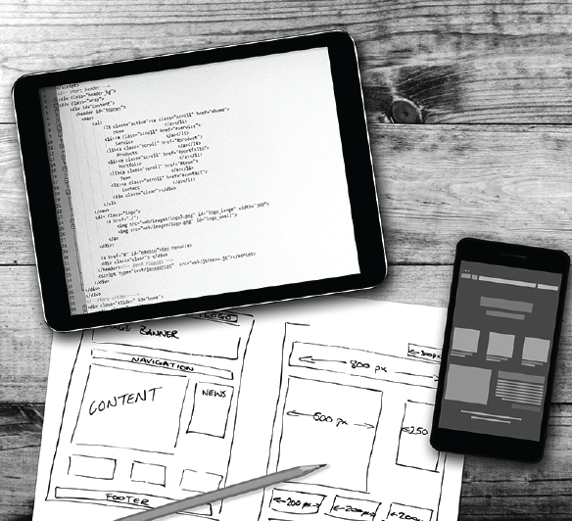
Wireframe

Slide 48
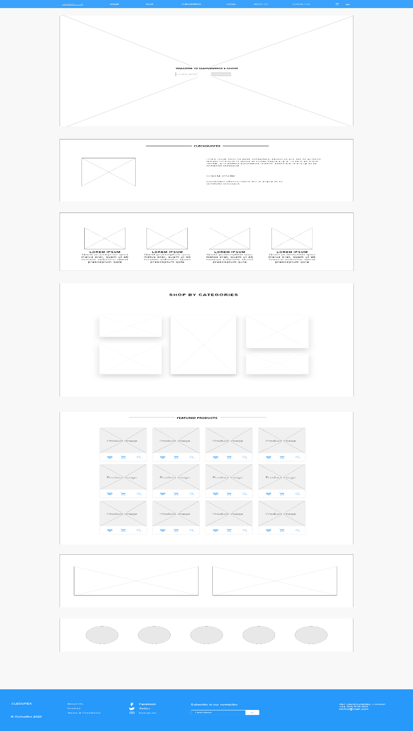
Home

Slide 49
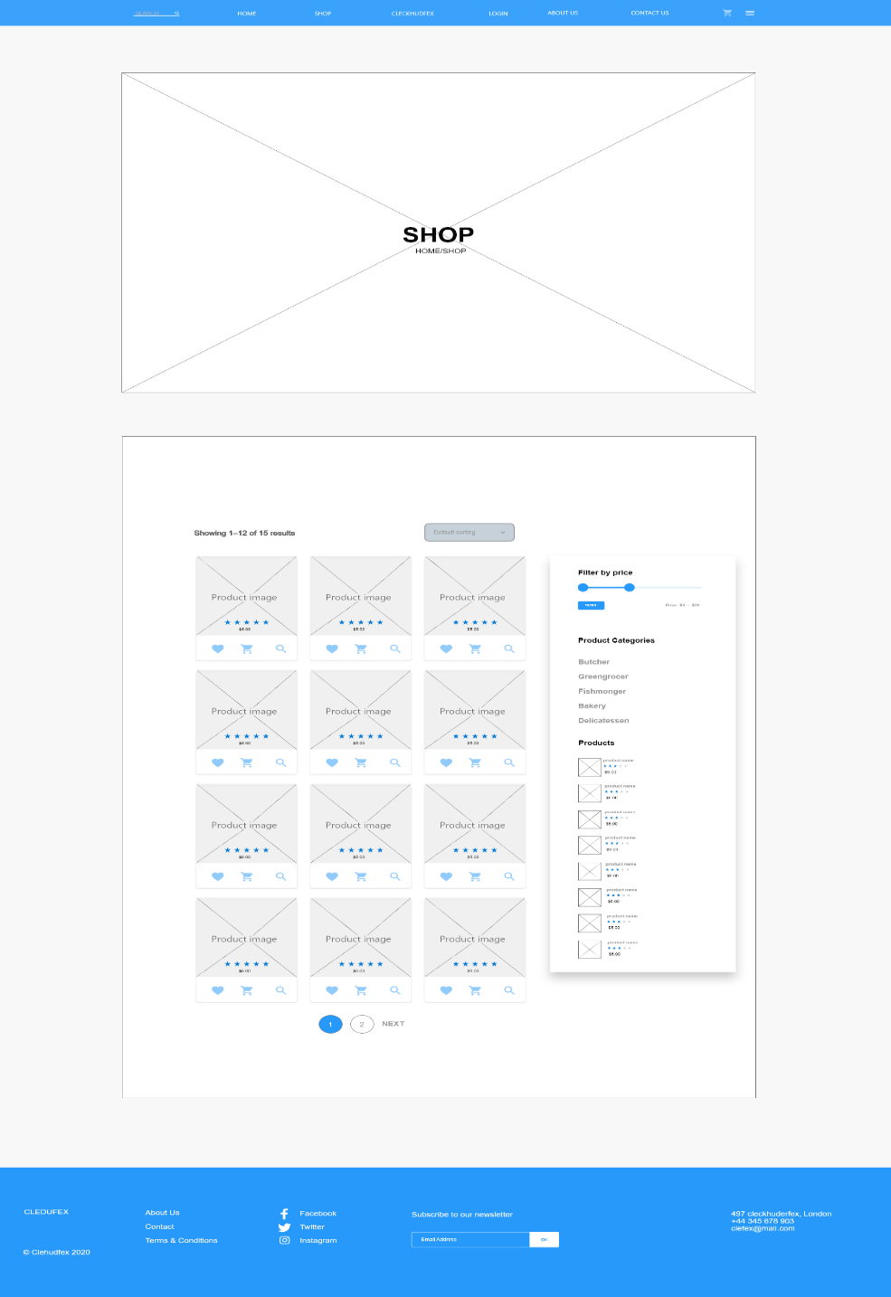
Shop

Slide 50
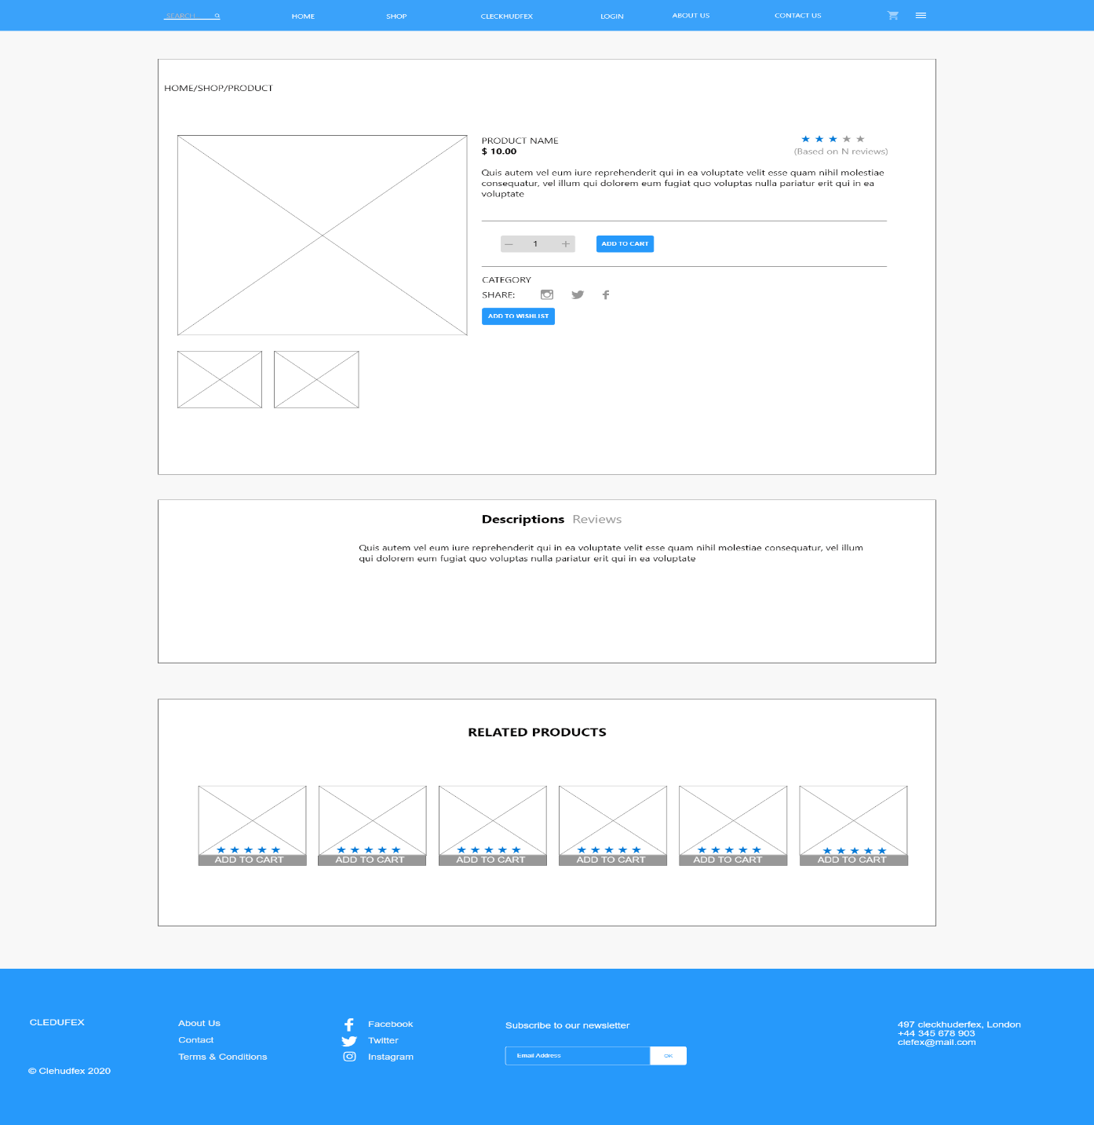
Single Page

Slide 51
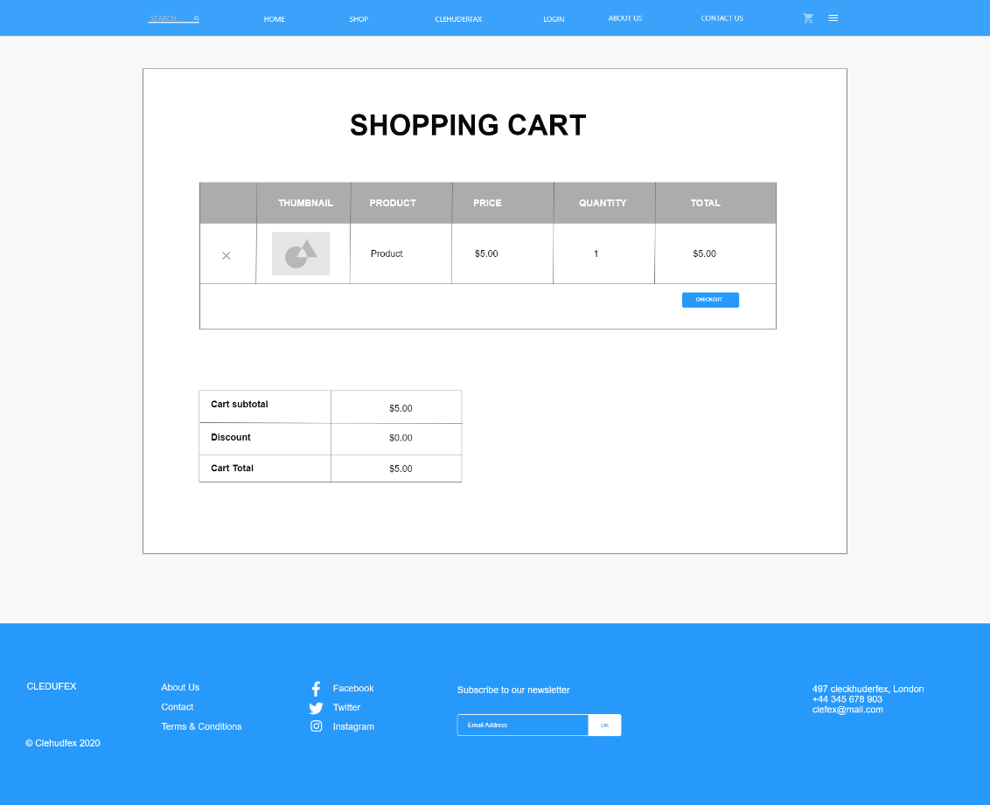
Cart

Slide 52
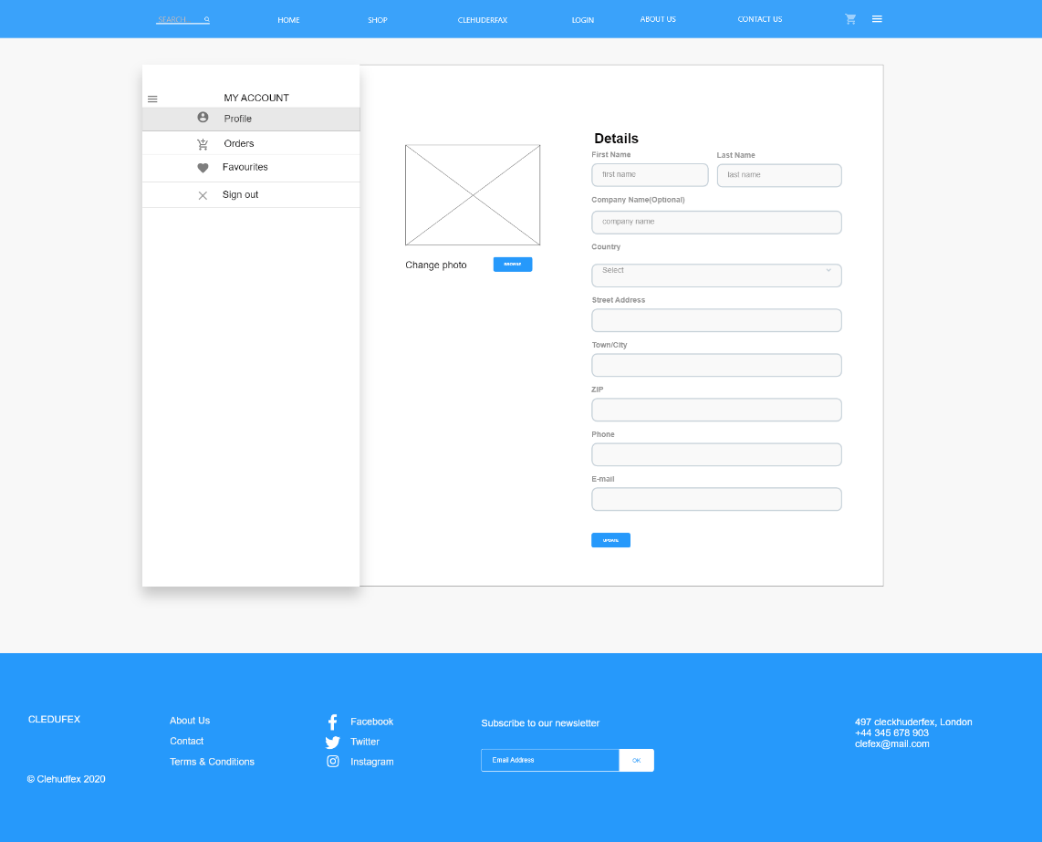
User Account

Slide 53
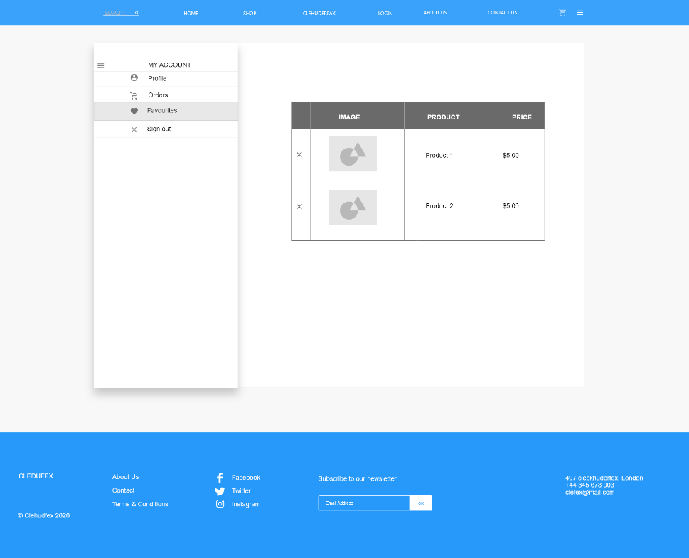
Favorites

Slide 54
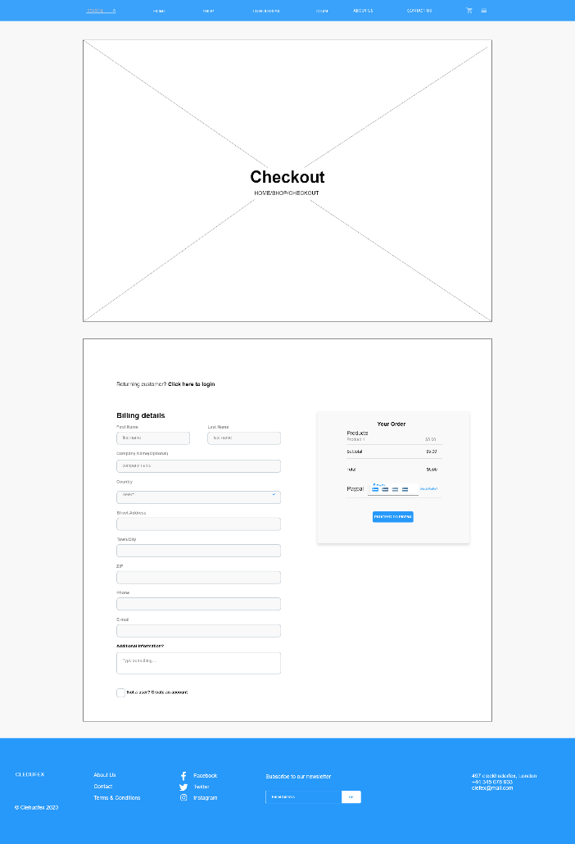
Checkout

Slide 55
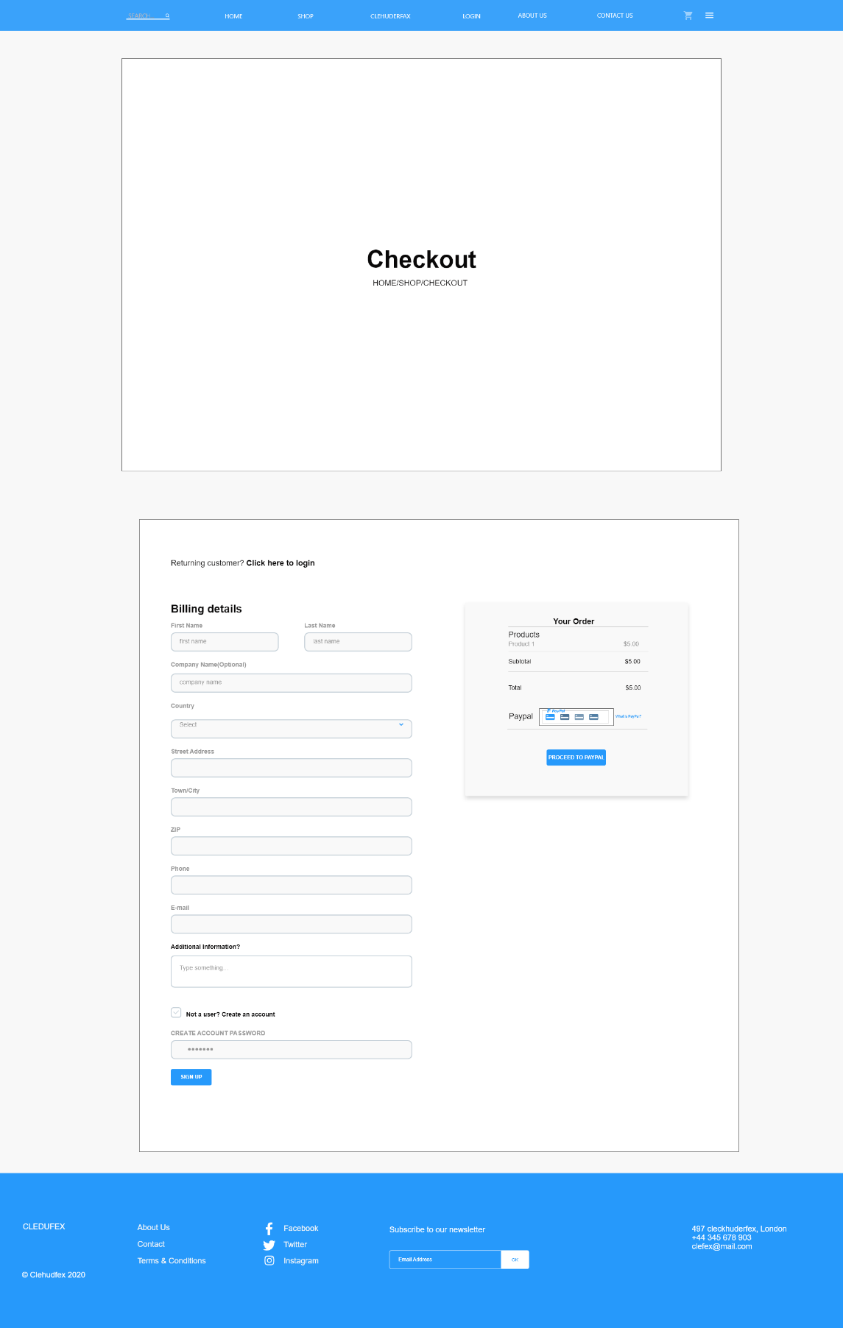
Signup

Slide 56
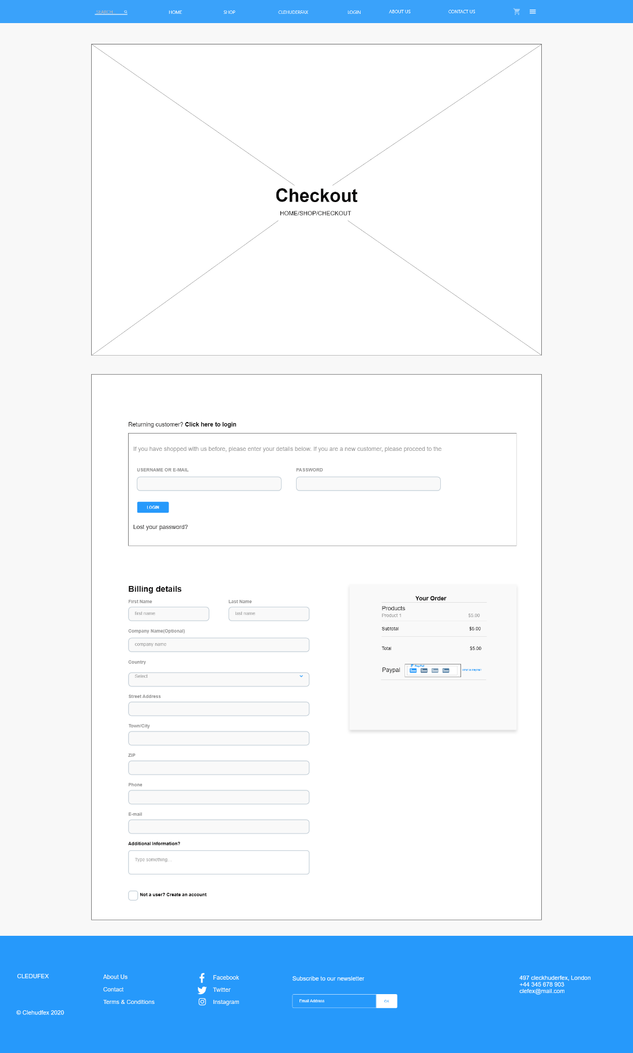
Log In

Slide 57
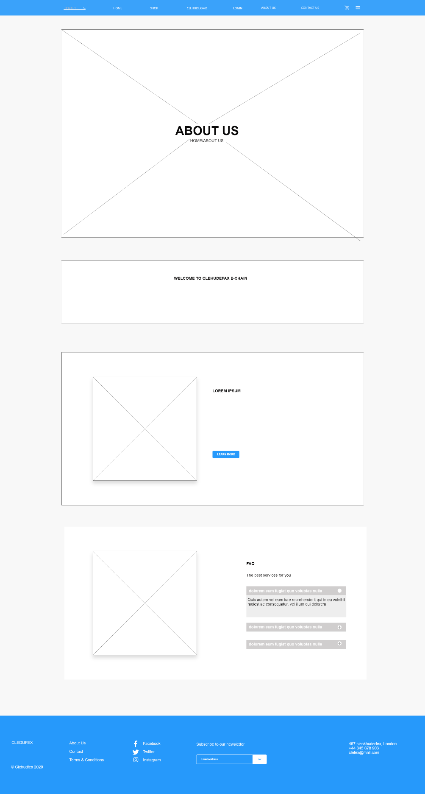
About Us

Slide 58
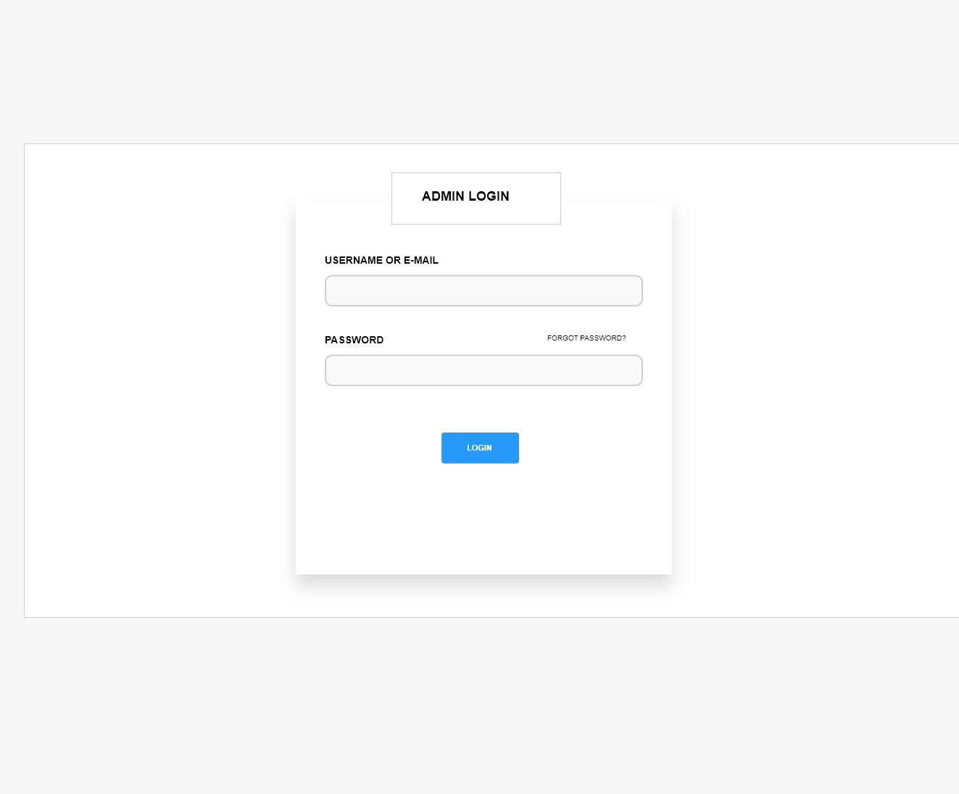
Admin Login

Slide 59
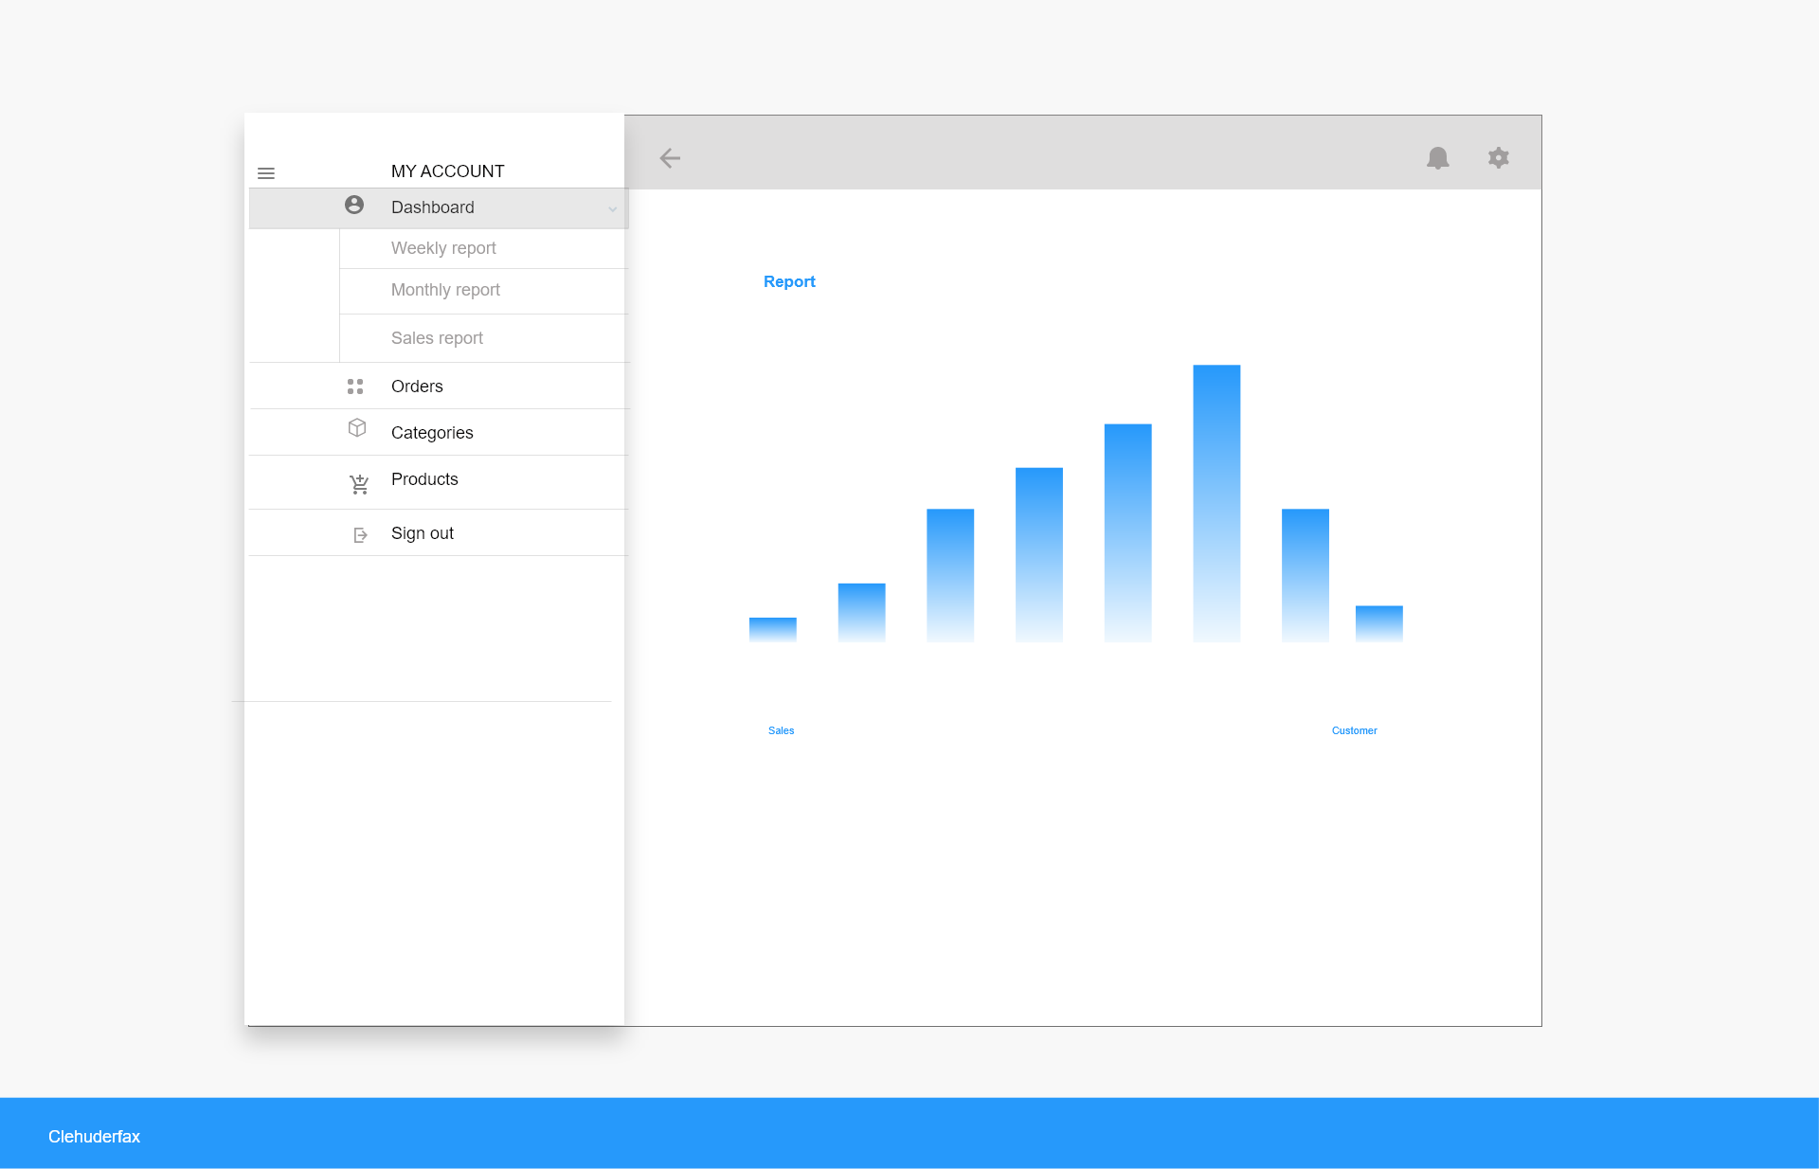
Admin Dashboard

Slide 60
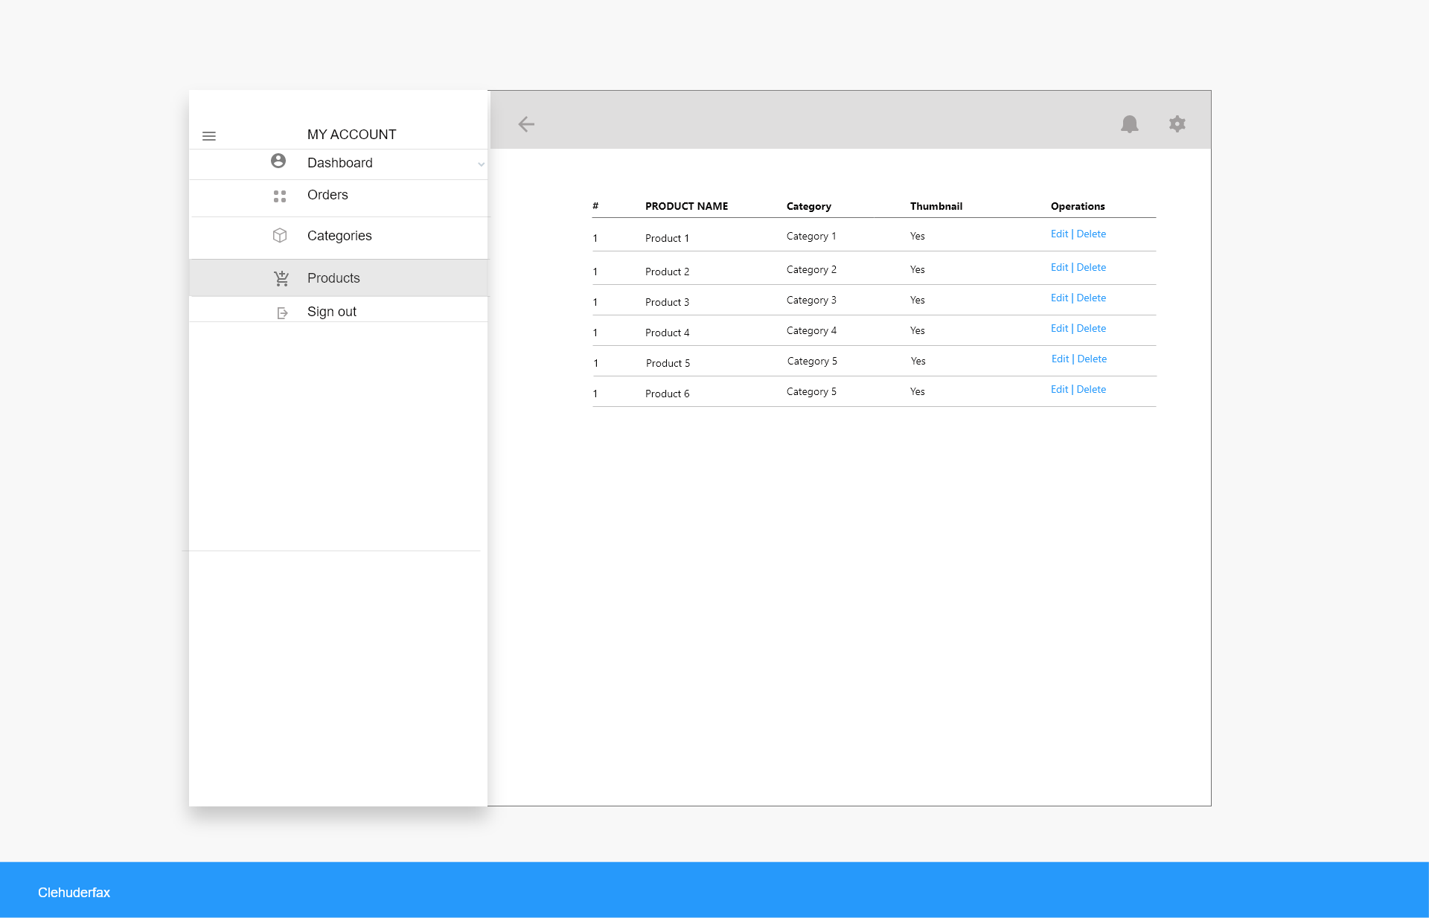
Admin Dashboard 2

Slide 61
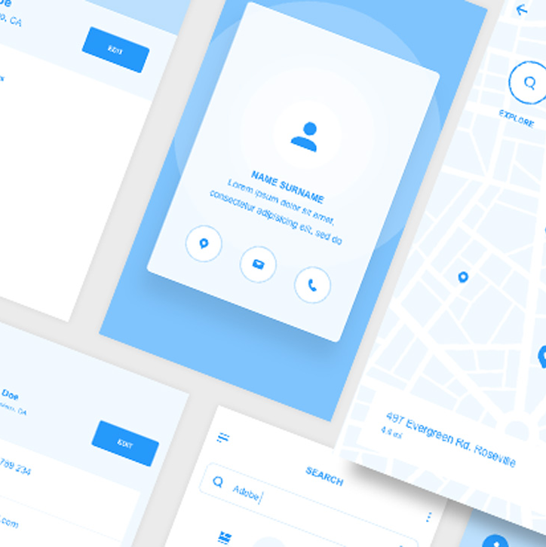
Website Mockup

Slide 62
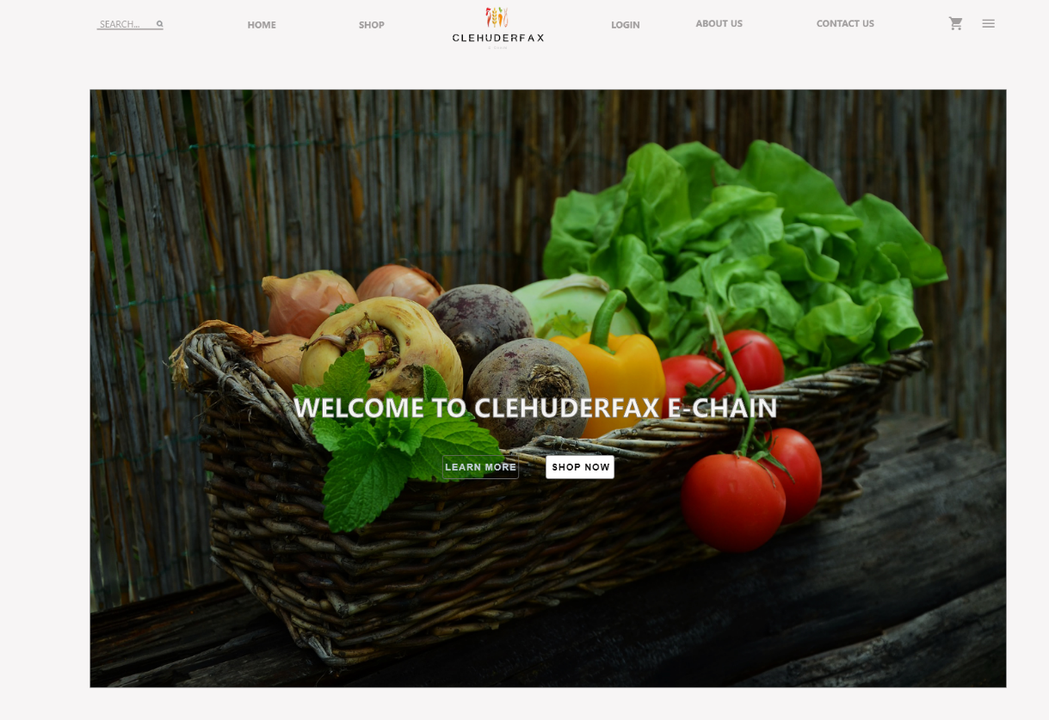
Home

Slide 63
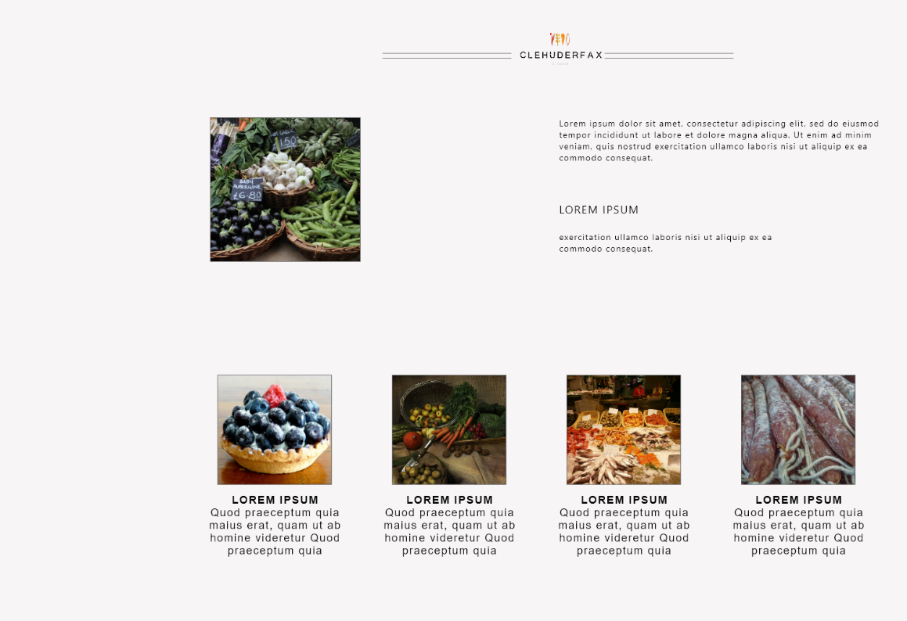
Home

Slide 64
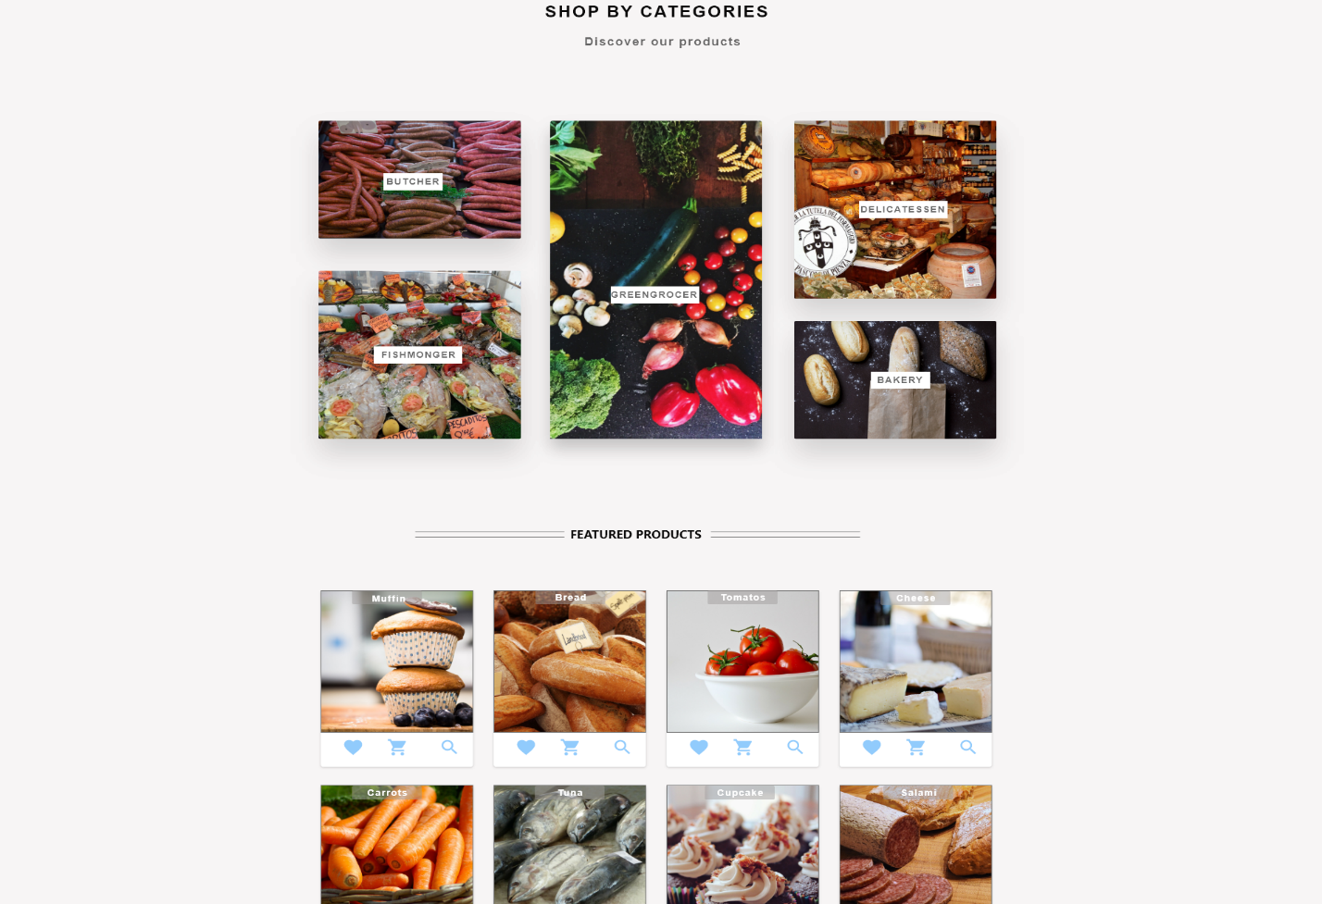
Home

Slide 65
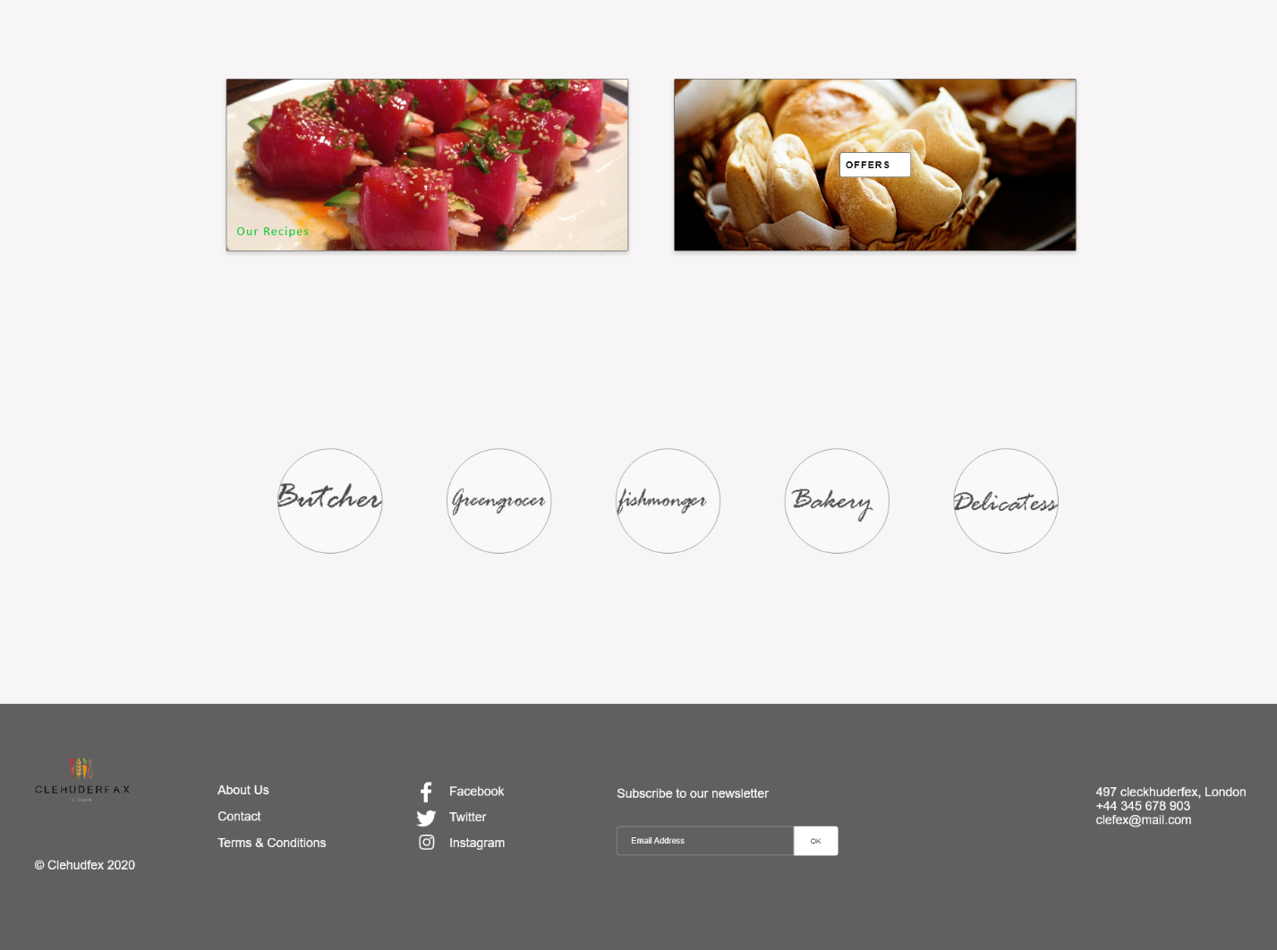
Home

Slide 66

Thank you

